Slide 1
Intro to Android App Development
Benjamin Romano
March 26, 2015
Notes:
Introduce self. Can ask questions during presentation if unclear

Slide 2
Overview
Basics of Android
How to setup development environment
Creating your first Android App using Java
Basics of Xamarin.Android
Creating your first Android App using Xamarin.Android
Example Code to follow along is at http://goo.gl/bRc1bs

Slide 3
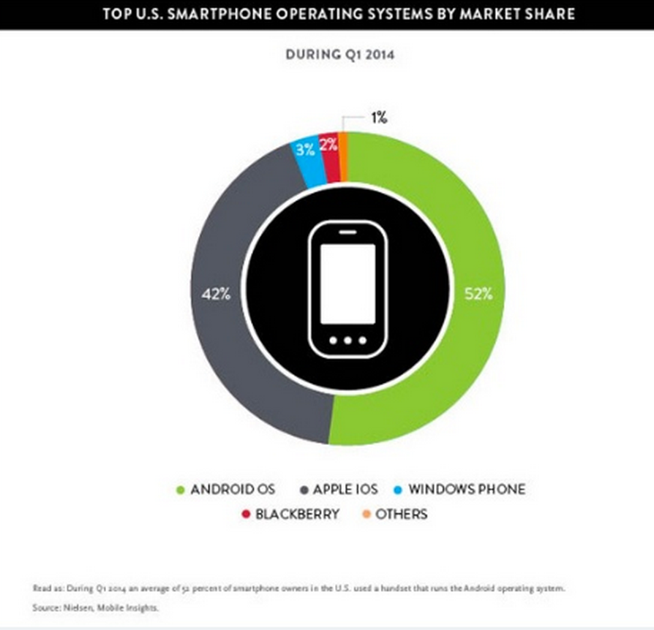
Why Develop for Android?
Largest User base
52% of devices are Android
Customizable
Runs on Java
Maintained by Google

Slide 4
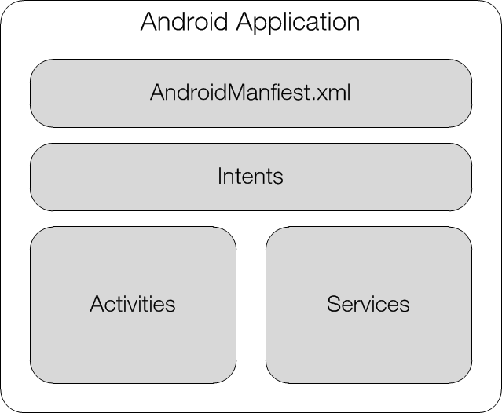
Android Application
Included in an .apk (Android Package) file

Slide 5
App Components
Activities
Single screen with a user interface (UI)
Services
Runs in the background (e.g. music player)
Content Providers
Data manager (e.g. accessing contact data, writing to database)
Broadcast Receivers
Responds to broadcasts (e.g. doing something when screen turns off)
Can create a status bar notification
Components can be called from other apps using Intents
Notes:
Building block of apps
Apps have multiple entry points

Slide 6
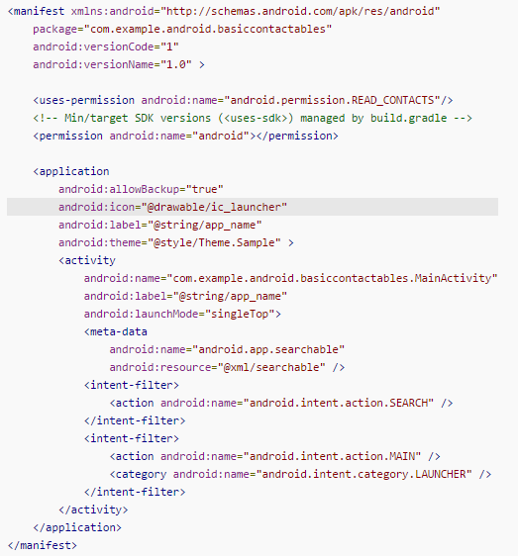
Android Manifest
Keeps track of android level required
Specify permissions required
Declare hardware/software features used (e.g. Bluetooth, camera)
API libraries needed (e.g. Google Maps library)
Define app components and intents
Much more…

Slide 7
Setting up the Environment
Need an IDE
Eclipse, Android Studio, Xamarin Studio, Visual Studio
Need the Android SDK
Included in Xamarin Studio and Android Studio installations
Visual Studio requires you to download Xamarin Studio
Xamarin Studio: http://xamarin.com/download
Android Studio: http://developer.android.com/sdk/index.html

Slide 8
Debugging Android
Emulators
Android SDK, Xamarin Android Player
Physical Device
USB
Wireless Debugging
Setting up wireless debugging:
Plug in device
$ > adb tcpip 5555
$> adb connect DEVICE_IP:5555
Going back to wifi:
$> adb –s DEVICE_IP:5555 usb

Slide 9
Java Demo

Slide 10
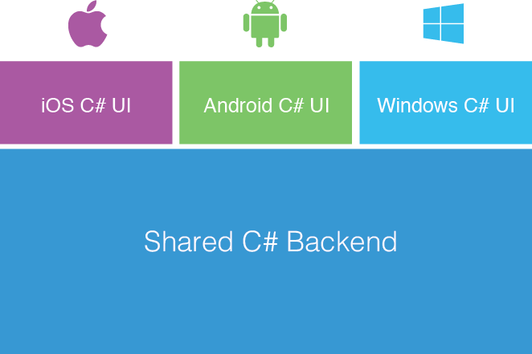
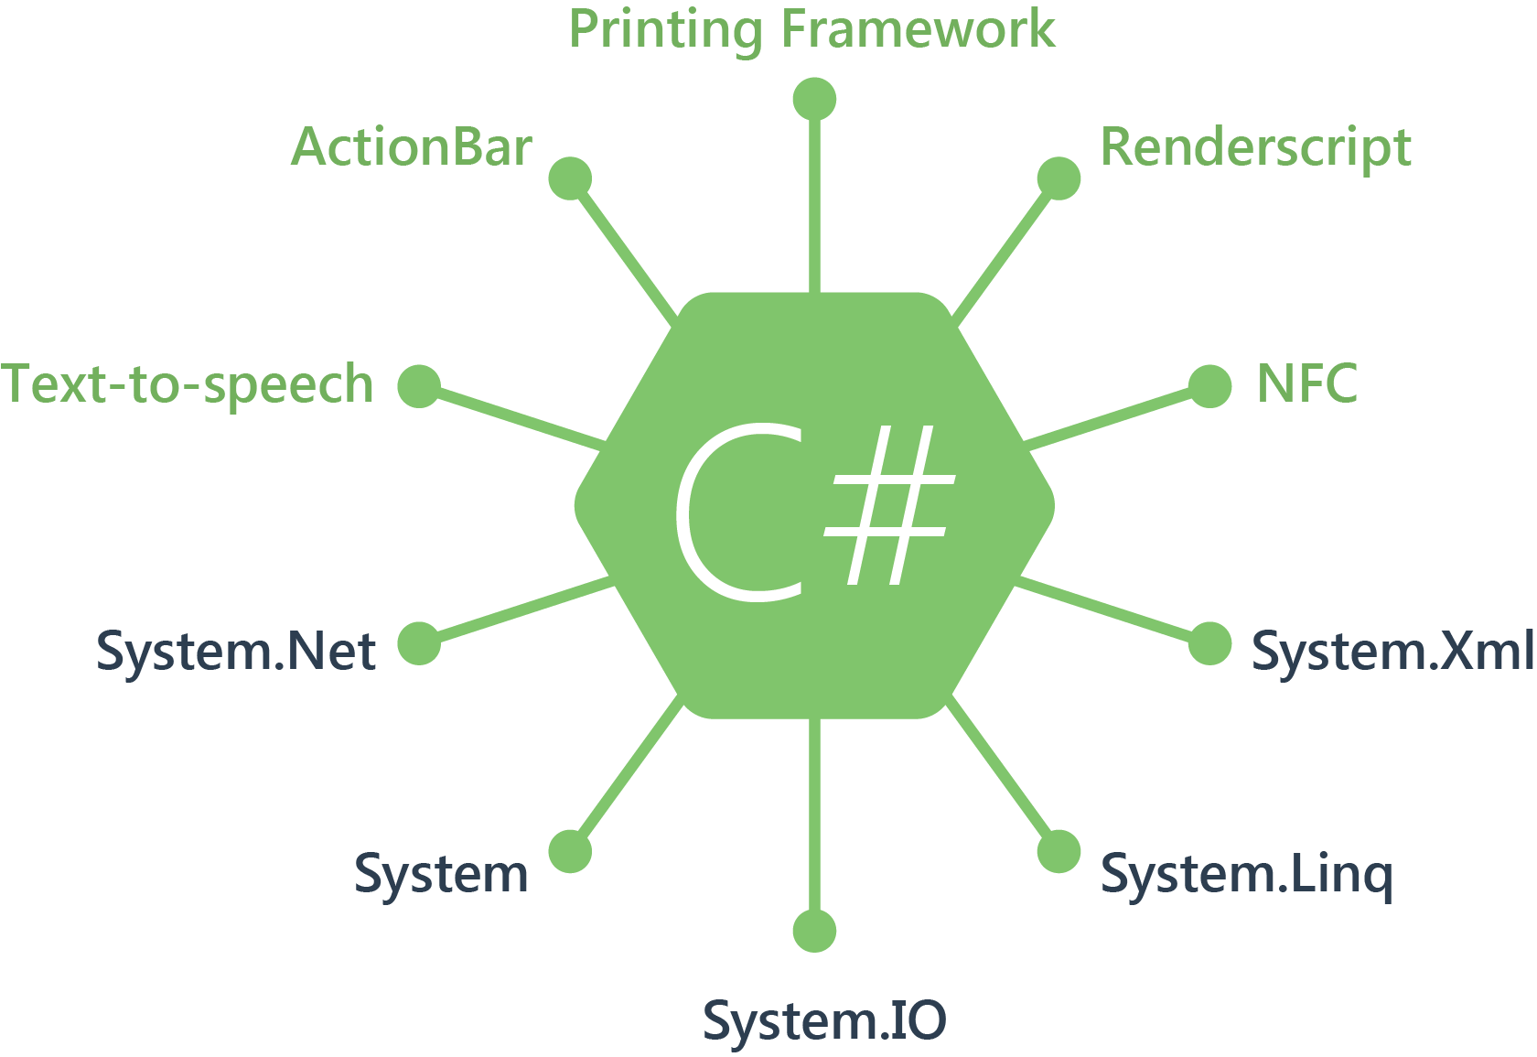
Xamarin.Android
Android development using C#
Mono Runtime bundled with app
Greater Code Re-use
Native Performance
Native User Interface

Slide 11
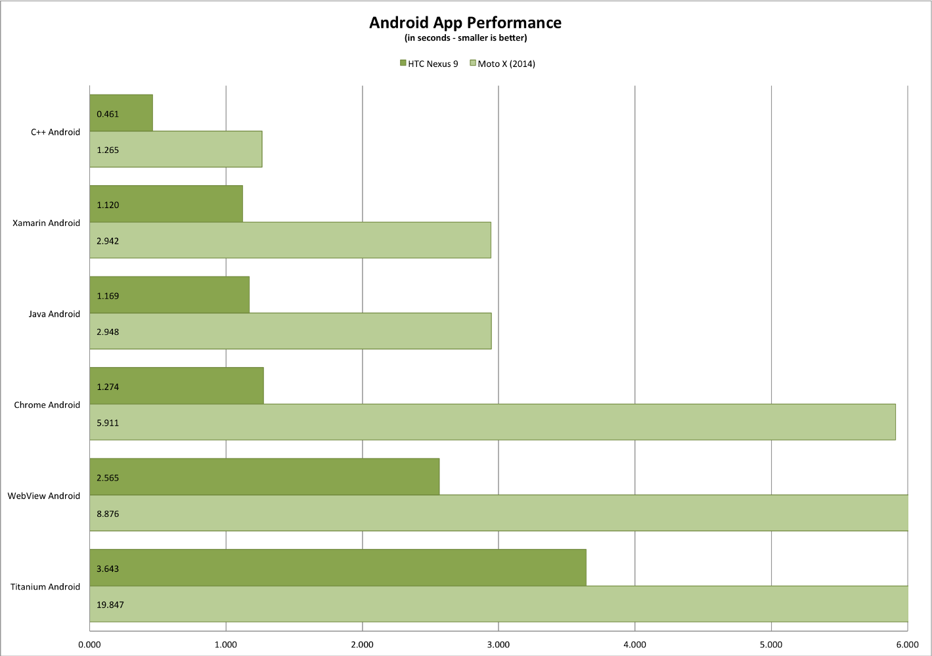
Xamarin.Android is faster than Java Android!

Slide 12
C# Demo

Slide 13
Questions?
Useful links:
http://developer.xamarin.com/
https://developer.android.com/guide/index.html
https://medium.com/@harrycheung/mobile-app-performance-redux-e512be94f976
http://benromano.com/

